Slide 1
Continuous Compliance for the Modern Enterprise
Tom Robinson-Gore

Slide 2
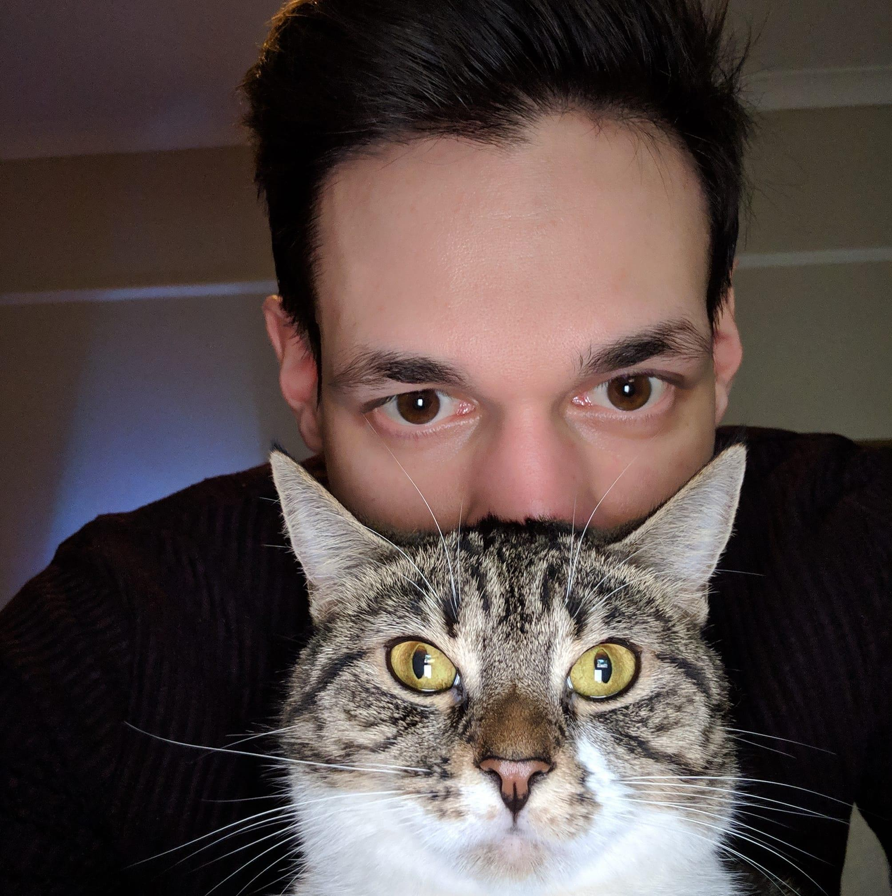
Me!
Solutions Architect @ Chef Software
Nordics
Benelux
DACH
Eastern Europe
Background in DevOps transformation and release automation
trg@chef.io

Slide 3
Success for the Modern Enterprise

Slide 4
Every company is a tech company

Slide 5


Idea
Ship

Slide 6
Friction exists throughout the process
Security controls in the wrong places
Sluggish change processes and approvals
Testing happens late, feedback is slow
Speed isn’t repeatable, doesn’t scale
Do InfoSec policies inhibit agility and speed?
81%
IT Professionals say “yes”
77%
Information Security professionals agree
Gartner, How to Seamlessly Integrate Security Into DevOps (2016)

Slide 7
Risk Mitigation

Slide 8






Risk Mitigation
SPEED
Measure of rate of software change
EFFICIENCY
Measure of effectiveness of software change
RISK
Measure of quality of software change
Deployment frequency
Time from commit to deploy
Change failure rate
Mean time to resolve
Conduct security reviews and complete changes

Slide 9

Three legged stool...

Slide 10


Tradeoff: Speed vs Risk
DevOps teams focus on faster innovation, potentially increasing risk
InfoSec teams focus on mitigating risk, potentially reducing speed

Slide 11
Tradeoff: Risk vs Efficiency
Ops want to just pick up a tool and get started with it without spending hours customizing it.
InfoSec teams want to make sure scanning tools cover all risks and controls of GDPR

Slide 12
Modern Enterprises excel in all three areas

Slide 13
Speed

Slide 14
Compliance as an innovation blocker
Scenario: A top financial services firm parks new applications in security reviews for up to a year before they can be released.
SPEED
Measure of rate of software change
Deployment frequency
Time from commit to deploy

Slide 15
The self-fulfilling prophecy is a false definition of the situation evoking a new behavior which makes the original false conception come true. This specious validity of the self-fulfilling prophecy perpetuates a reign of error. For the prophet will cite the actual course of events as proof that he/she was right from the very beginning.
Wikipedia - 2019

Slide 16
Efficiency

Slide 17
Lack of testing throughout the SDLC
Scenario: A leading retailer takes four months to deliver new functionality to its mobile app, and half of all updates break something.
EFFICIENCY
Measure of effectiveness of software change
Change failure rate
Mean time to resolve

Slide 18





Lack of testing throughout the SDLC
In a development workflow
As part of a build pipeline
In production
On long lived / legacy systems

Slide 19
Lack of testing throughout the SDLC
In a development workflow
As part of a build pipeline
In production
On long lived / legacy systems

Slide 20
Risk

Slide 21
Painful and wasteful audits
Scenario: A healthcare giant wastes thousands of hours on audits and still struggles to stay in compliance.
RISK
Measure of quality of software change
Conduct security reviews and complete changes

Slide 22

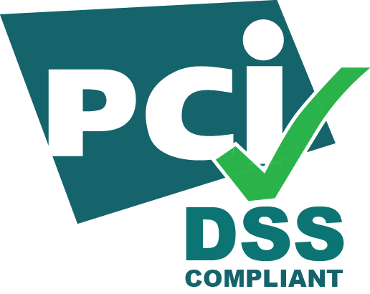





Slide 23
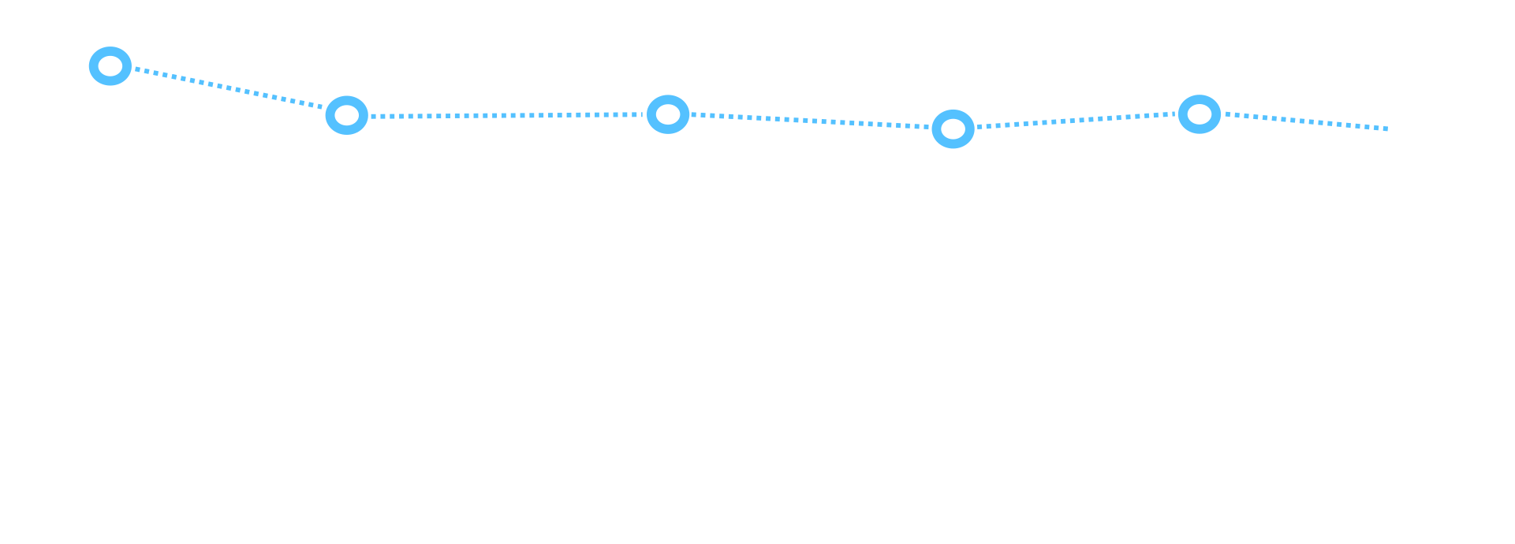
Audit 1
Audit 2
Audit 3
Audit 4
Audit 5
Passing controls

Slide 24

Faulty assumptions
Audit 1
Audit 2
Audit 3
Audit 4
Audit 5
Passing controls

Slide 25
Continuous Compliance
Increasing speed, maintaining efficiency and reducing risk

Slide 26
Audit 1
Audit 2
Audit 3
Audit 4
Audit 5
Passing controls

Slide 27
Audit 1
Audit 2
Audit 3
Audit 4
Audit 5
Passing controls

Slide 28
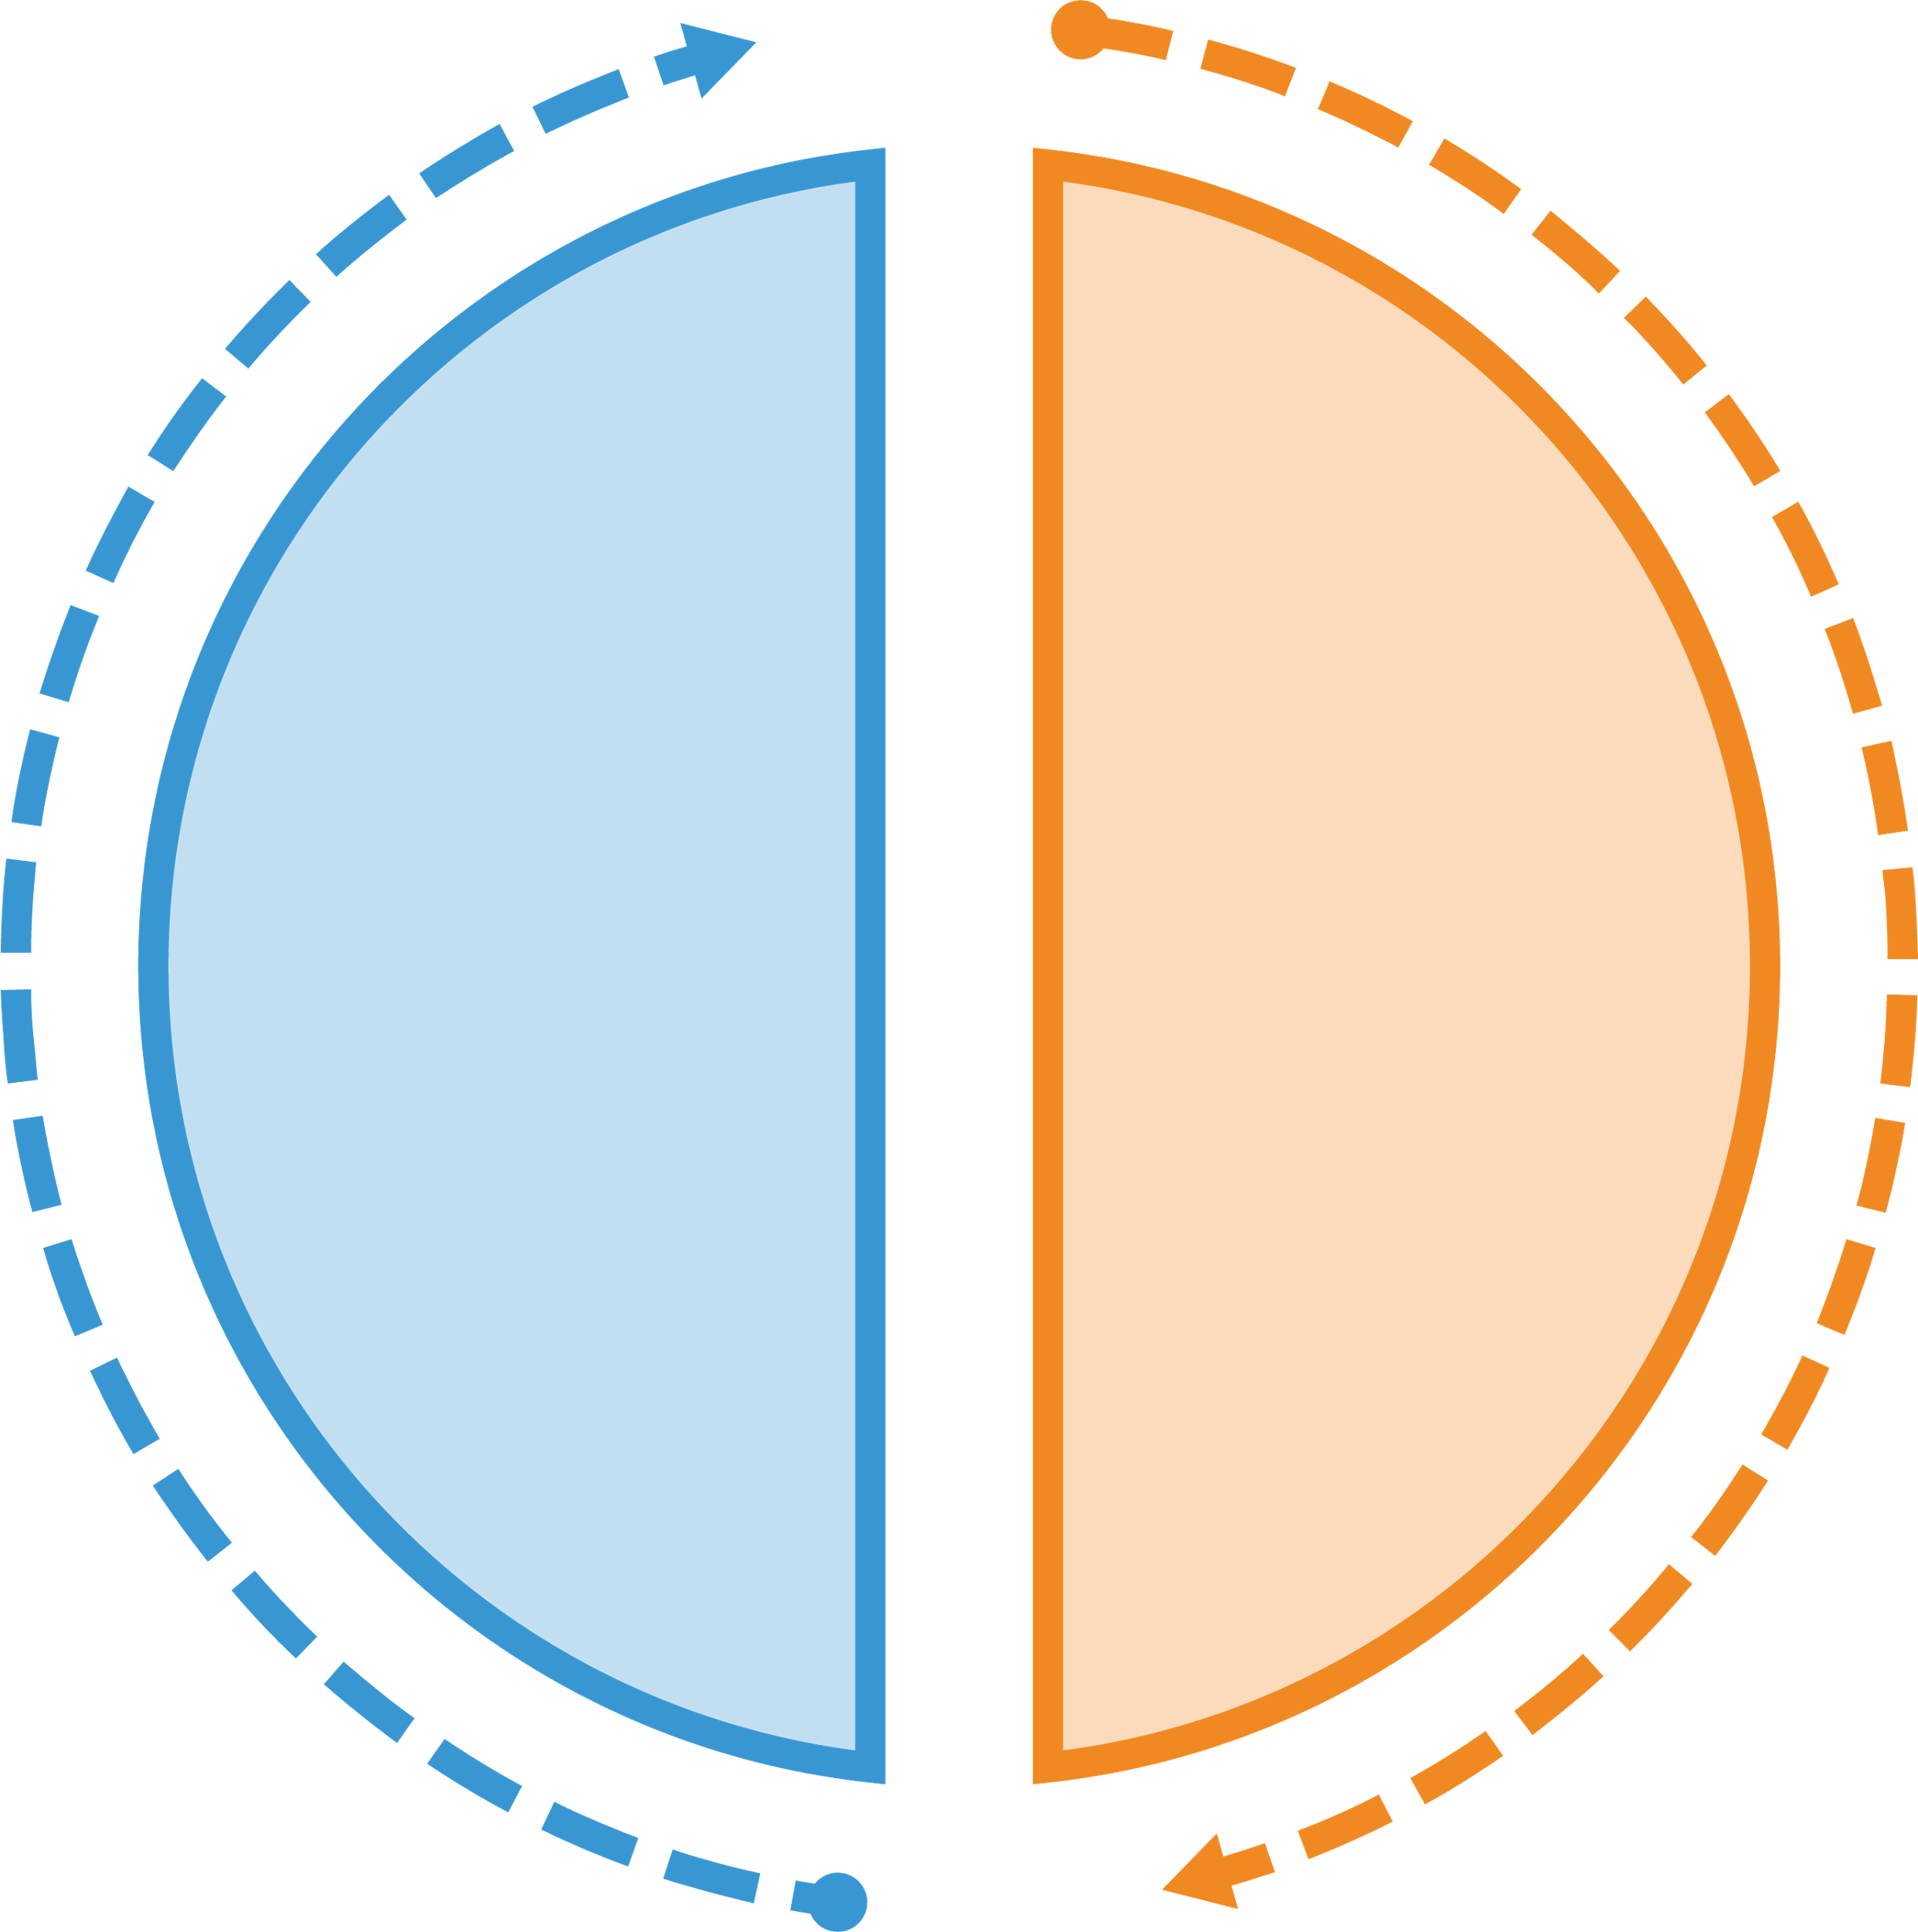


Continuous Compliance
Detect
Correct

Slide 29

Automation!

Slide 30

Detect

Slide 31
Detect - Operating System security
control 'cis-enforce-password-history-1.1.1' do impact 0.4 title '1.1.1 Set Enforce password history to 24 or more passwords' desc 'Set Enforce password history to 24 or more passwords' describe security_policy do its('PasswordHistorySize') { should be >= 24 } end end

Slide 32
Detect - Application security
control 'mysql_configuration' do impact 0.7 title 'MySQL Configuration' desc 'Ensure MySQL is running on the correct port' describe mysql_conf do its('port') { should eq '3306' } its('socket') { should eq '/var/run/mysqld/mysql.sock' } end end

Slide 33
Detect - Cloud Infrastructure security
control 's3_bucket_security' do impact 0.7 title 'S3 bucket should exist and be private' desc 'Simple example of AWS S3 scanning' describe aws_s3_bucket('test_bucket') do it { should exist } it { should_not be_public } end end

Slide 34








Inspec Profiles
Amazon Linux
2014.09 / 2015.03
CentOS
6 / 7
HP UX
11i
IBM AIX
5.3 / 6.1 / 7.1
RHEL
6 / 7
SLES
11 / 12
Ubuntu Server
12.04 / 14.04 / 16.04
Windows
7 / 8 / 10 / 2012 / 2012R2 / 2016 / Nano
Notes:
We already make technical baselines available for a range of platforms that can form the foundation of your own GDPR auditing.

Slide 35

Continuous Compliance
Detect
Correct

Slide 36
Compliance as an innovation blocker
Scenario: A top financial services firm parks new applications in security reviews for up to a year before they can be released.
SPEED
Measure of rate of software change
Can release to entire infrastructure of 70,000 nodes within 6 hours of a release being made available
Deployment frequency
Time from commit to deploy

Slide 37
Lack of testing throughout the SDLC
Scenario: A leading retailer takes four months to deliver new functionality to its mobile app, and half of all updates break something.
EFFICIENCY
Measure of effectiveness of software change
10 seconds to deploy the app with little risk of failure. When extended across 200 apps, the company expects to save $1.6M in operational costs, while significantly reducing time to value.
Change failure rate
Mean time to resolve

Slide 38
Painful and wasteful audits
Scenario: A healthcare giant wastes thousands of hours on audits and still struggles to stay in compliance.
RISK
Measure of quality of software change
Eliminated $2M in security and network management software toolset costs while reducing remediation time across thousands of servers from weeks to one hour
Conduct security reviews and complete changes

Slide 39
Testing throughout the SDLC
In a development workflow
As part of a build pipeline
In production
On long lived / legacy systems
Compliance by Design!

Slide 40
Further information
Documentation and resources – https://inspec.io
InSpec and Compliance tutorials – https://learn.chef.io
Engage with the community - https://www.chef.io/summits/
Come and talk to us! - Stand 16

Slide 41
Thank you!

